Slide 1
Purchasing Molecules for Biologic and Chemical use Cases using Chemistry Commons
Chemistry Commons Tutorial
By Maksim DuNova

Slide 2
Finding a Reaction Center
Let’s say you are someone who is looking for a specific Chemotype center in the molecules that you are interested in.
Let’s say that Chemotype is a Sulfoximine center.
First step is to go to the Chemistry Commons Reactions tab to search for that type of reaction center in the webpage searchbar
If that reaction center exists it should look up. Try other naming conventions or search manually if that doesn’t work. Please go to our discord page to submit input on naming or other things you find wrong. Feedback is very appreciated!

Slide 3
Check Reaction Center 1
You can filter further by using the Apply Tags Function to narrow down results.
Ir reactions are bespoke reactions that are published by chemists in a lab group.
Fe reactions are reliable reactions that many chemists can do such as Enamine.

Slide 4
Check Reaction Center 2
You can filter further by using the Apply Tags Function to narrow down results.
Ir reactions are bespoke reactions that are published by chemists in a lab group.
Fe reactions are reliable reactions that many chemists can do such as Enamine.
Click on the bar/eye of a specific reaction you like.

Slide 5
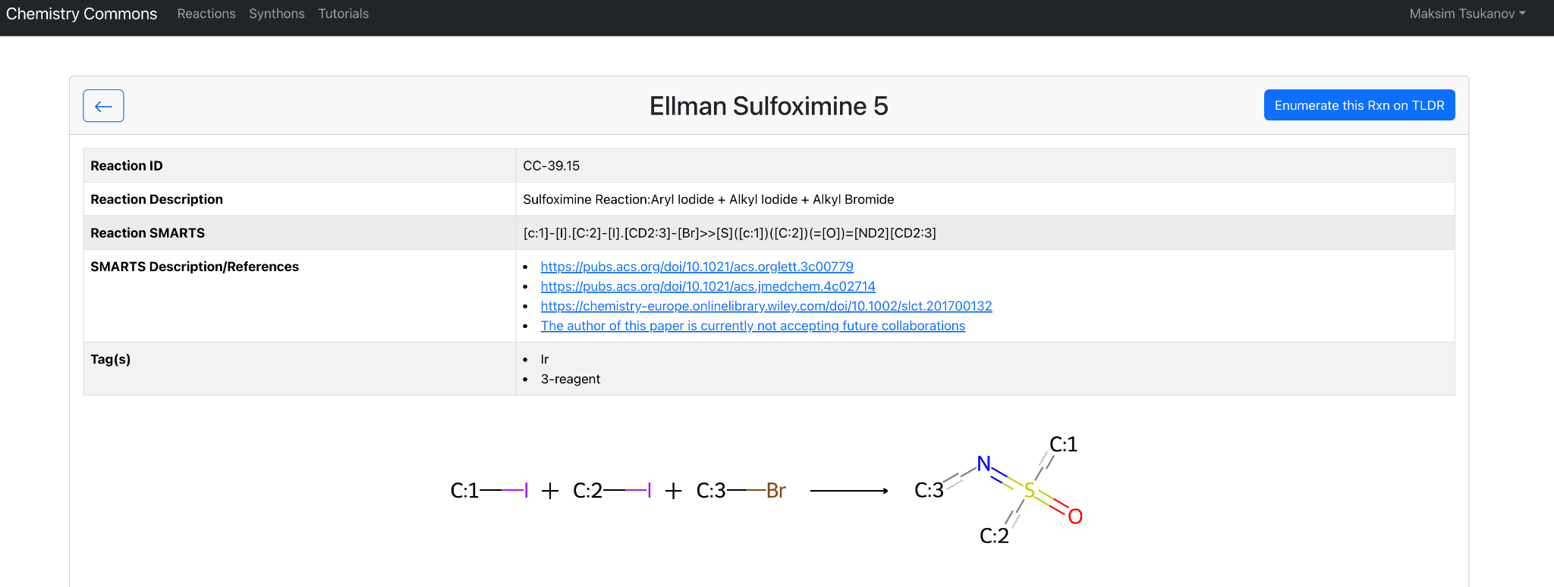
Check Reaction Center 3
In this case we are looking at an Ir reaction that contains 3 reagents to make.
If it’s an Ir reaction make sure to check if the author is willing to collaborate by checking the SMARTS Description/References. If not, you can pursue further on your own terms. Otherwise contact us and we’ll we connect you to the specified lab.
Fe reactions can be done by most corporate and lab chemists.
Note: In this case the author is not accepting future collaborations to make the molecules but we will continue with this example.

Slide 6
Check Reaction Center 4
In this case we are looking at an Ir reaction that contains 3 reagents to make.
If it’s an Ir reaction make sure to check if the author is willing to collaborate by checking the SMARTS Description/References. If not, you can pursue further on your own terms. Otherwise contact us and we’ll we connect you to the specified lab.
Fe reactions can be done by most corporate and lab chemists.
Note: In this case the author is not accepting future collaborations to make the molecules but we will continue with this example.
Check if reaction center is correct by looking at the molecular drawing.

Slide 7
Enumeration 1
After you find the reaction you are looking for check the downloads tab to see if there is file of a list of enumerated molecules that are based on that reaction.
If not you can use our API: to enumerate the reaction yourself.

Slide 8
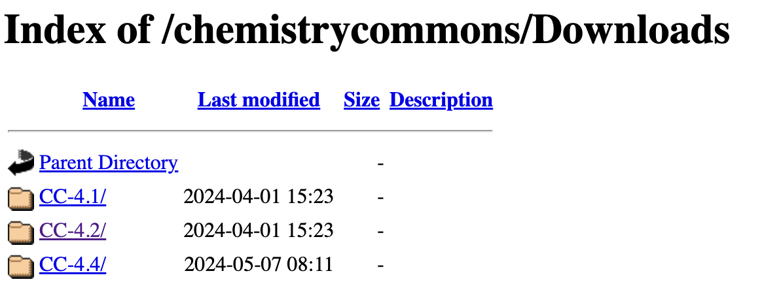
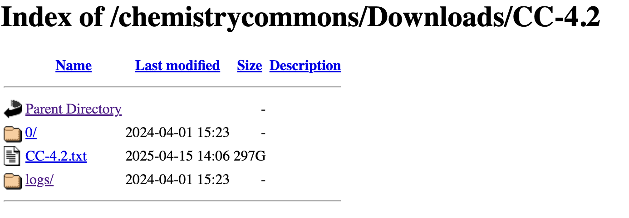
Enumeration 2
If you are looking in the Downloads tab you can find the reactions base on the CCID( Chemistry Commons Identification Number) ex. CC-4.2
Go down the directory and then download the list on enumerated reactions you are looking for. The enumerated list should be called CC-ID.txt ex. CC-4.2.txt

Slide 9
Enumeration 3
If you searched through didn’t find any relevant enumerations or are in need of enumerating you can run enumerations through our API:
/reaction/enumerate -X POST -F bblib=@bblib.smi -F rxn_id=’CC-10.11’
= use reaction CC-10.11 and building blocks that I upload to enumerate molecules
/reaction/enumerate -X POST -F bblib=’bb-50’ -F rxn_id=’CC-10’
= use reaction CC-10.11 and on-server BBs “bb-50” to enumerate molecules
Results:
/results/<task_id>
Contact the lab if you need further information or assistance

Slide 10
Enumerated File 1
-Once you have your Enumerated File the structure should look like this:

Slide 11
Enumerated File 2
-Each line is in the order of: Enumerated Compound, EnumerationID, Tranche, Reactant1, Reactant2, … , ReactantN

Slide 12
Enumerated File 3
EnumerationID(seperated by _) contains:
The ReactionID/CCID is the ID of the reaction used to enumerate(Found in the Chemistry Commons Reactions page)
The LibraryID is the ID of the library used to source the compound(In this instance it is the ID of the Chemspace Building Block Library)
The CompoundID is the ID of the compound from library it was found in(In these instances all the CompoundIDs are from the Chemspace Building Block Library)
Then you get an additional LibraryIDs with CompoundIDs based on the number of reactants
Tranche contains:
Heavy Atom Count of Enumerated Compound(in this case 27 Heavy Atoms)
LogP range of Enumerated Compound(in this case logP=4.70-4.79)

Slide 13
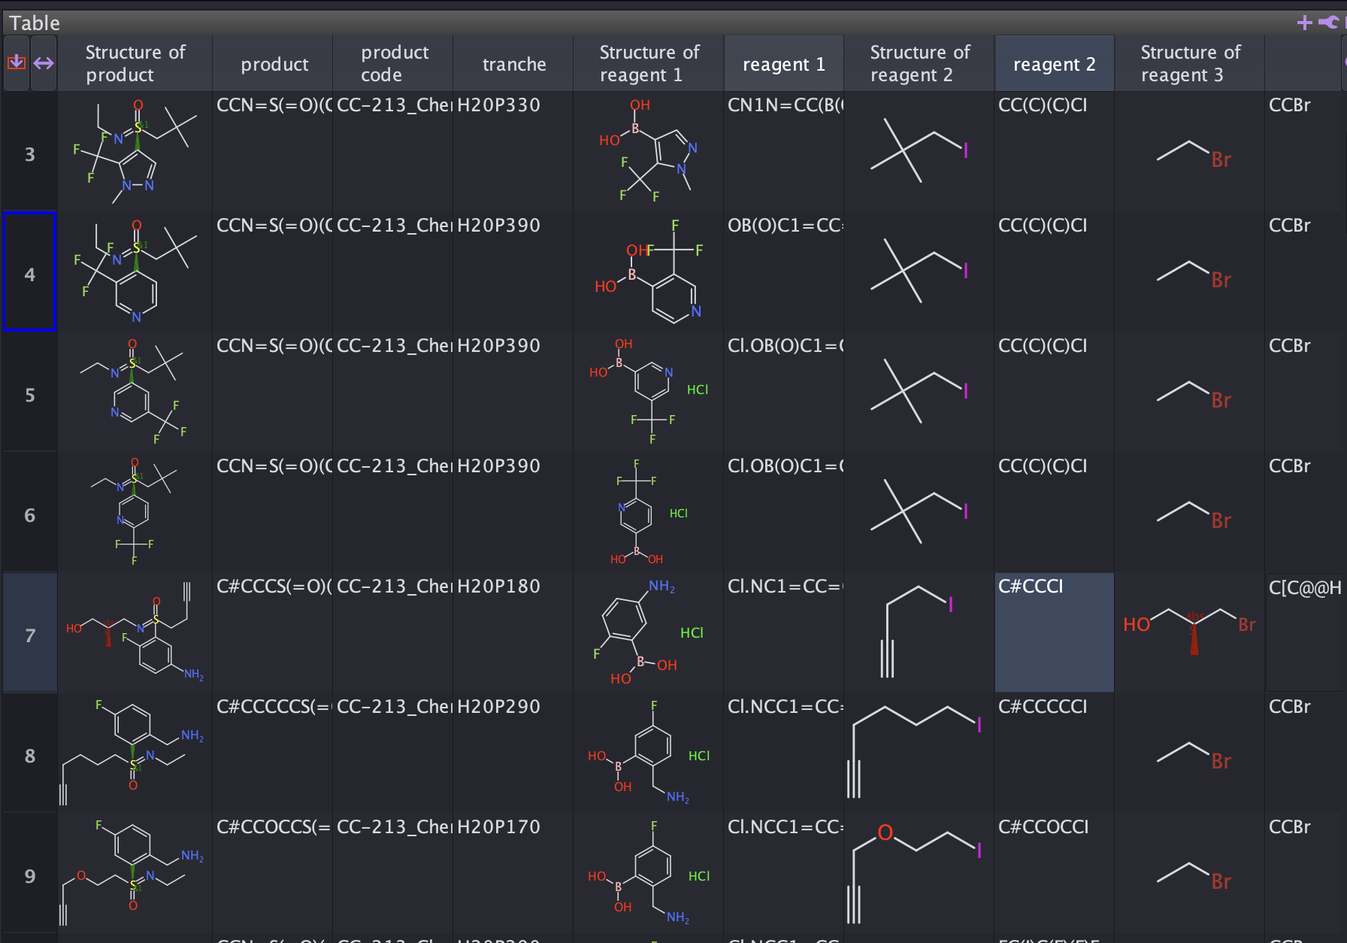
Datawarrior
You can download a program called datawarrior to help you visualize the enumerated and reactant molecules using the enumerated file

Slide 14
Purchasing 1
Choose a list of compounds that you are interested in from the Enumerated list(or choose all)
You can then search our website Cartblanche for the compound/s using the SMILES(recommended), compoundID, or ZINCID if it has one(ex.ZINC9q0000000BI0)

Slide 15
Purchasing 2
Once you get your results, I recommend going to the ZINC20 tab to see more vendor results of your desired compound, but both tabs work
Click on the molecule to go to the molecule description page or press add all to cart.

Slide 16
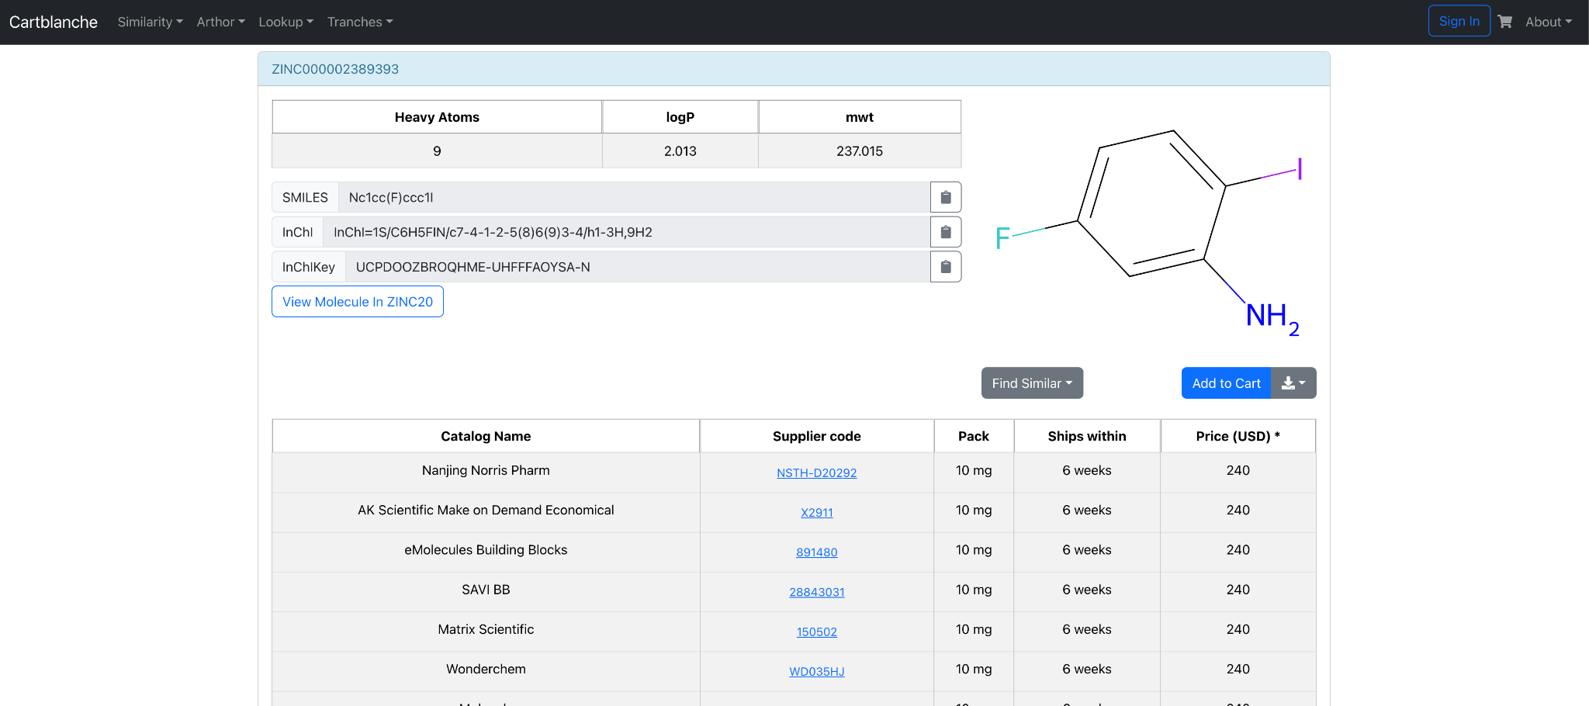
Purchasing 3
In the molecule description page you can see all the suppliers from where you can purchase the molecule and you can compare prices

Slide 17
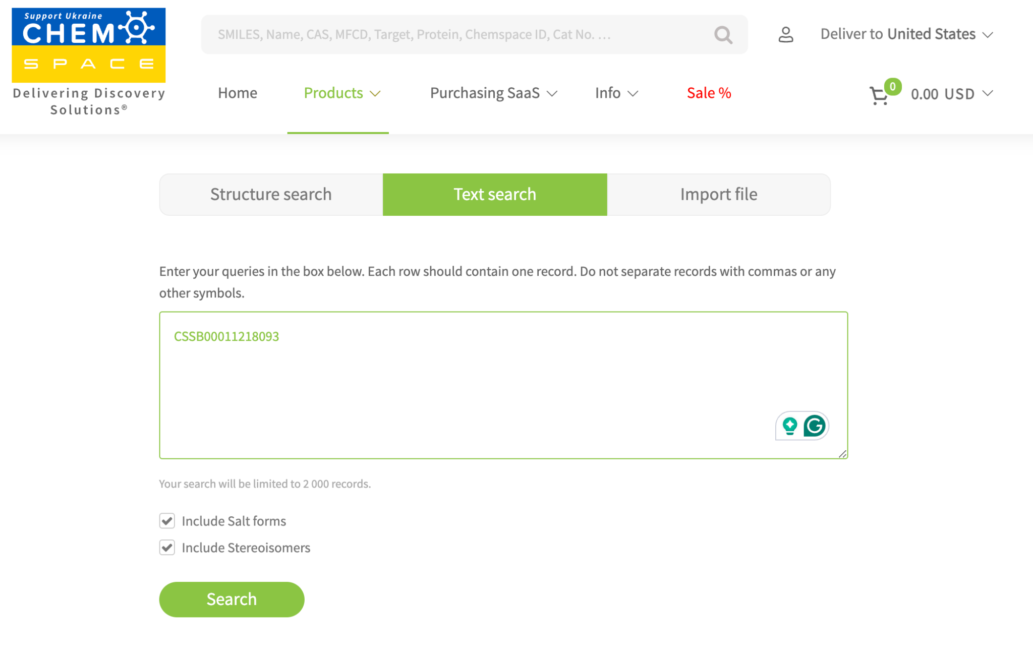
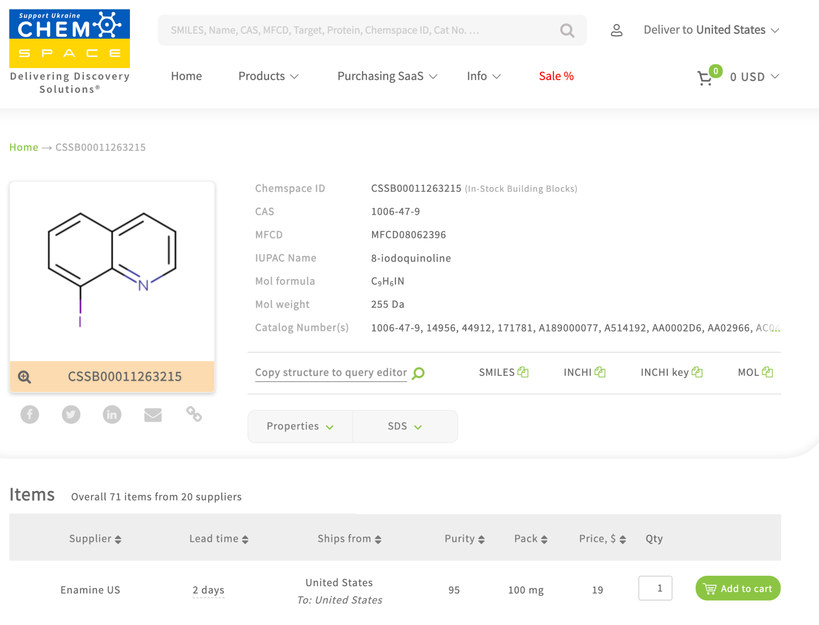
Purchasing 4
An alternative method, which depends on the supplier and library is to go directly to the supplier’s website and search with the compoundID and/or SMILES. For this instance you can use the Chemspace website.

Slide 18
Synthesizing
Once you have compound/s you want to make, know where to purchase the reagents, and know which reaction to use then you can either perform the reaction yourself to get the desired compound or have someone else do the reaction for you.
For IR reactions we recommend collaborating with the original lab where the reaction was made or see if they can connect you to a lab that can also perform the synthesis.
For Fe reactions we recommend you either synthesize yourself assuming you have a chemist and lab on hand or talk to a company that can do this for you such as Enamine.

Slide 19
Analoging
If you feel that you want to change the compounds in any way or found a good molecule hit and want to explore similar molecules further we recommend using our tools BAT(Bioisostere Anlaloging Tool) and AB3(Analog by Building Block) on the website header to further explore molecules.

