Slide 1
Adding Reactions into the Chemistry Commons, Retrosynthetic Analoging, and Reaction Enumeration
Elllman Tetrahydropyridine Reaction
By Maksim DuNova

Slide 2
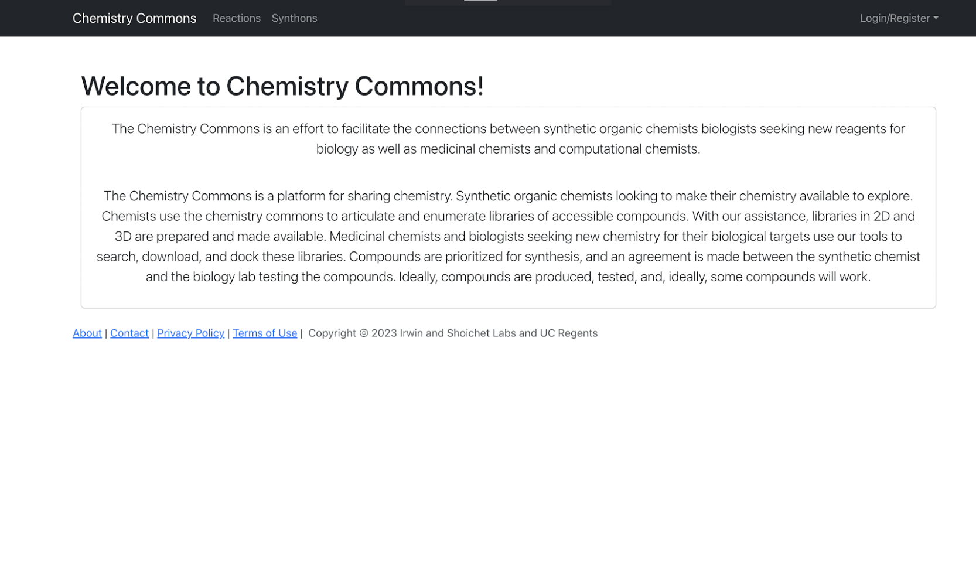
Chemistry Commons
The goal of Chemistry Commons is to make an interactive space for chemists to facilitate collaboration on reaction curation and to share their own reactions for the purpose of exploring chemical space!

Slide 3
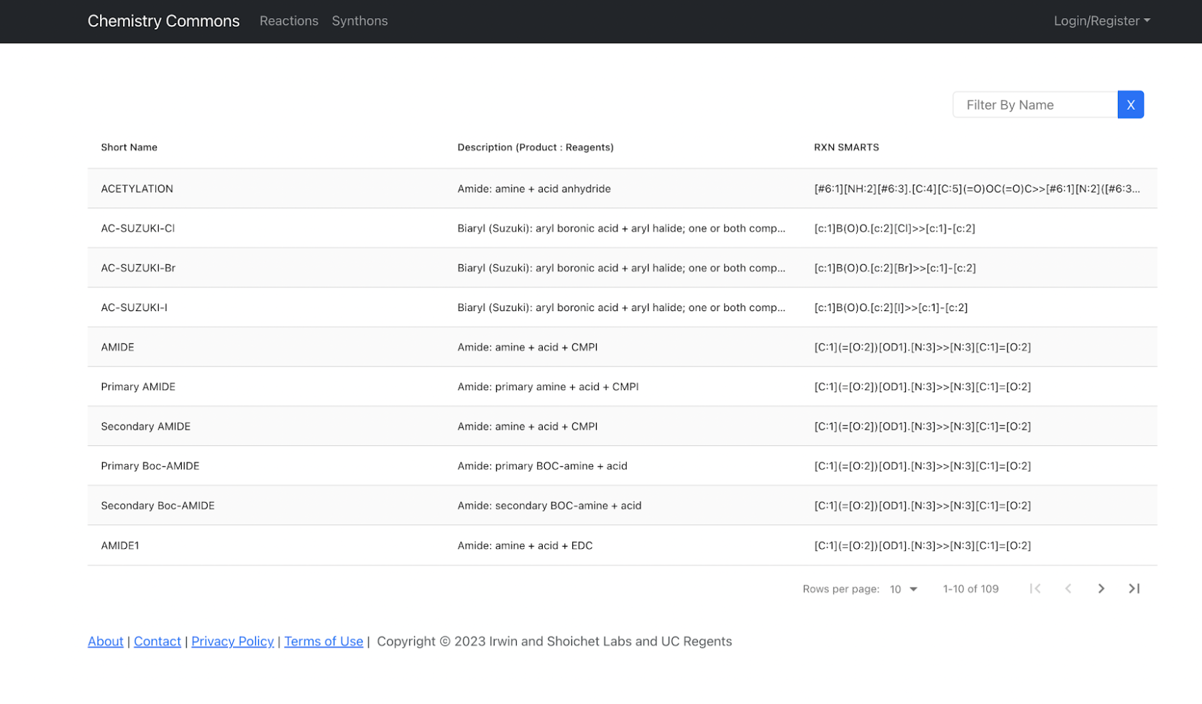
Reaction Database
Notes:
Reaction database that collects curated reaction SMARTS. Precursor to exploring chemical space!

Slide 4
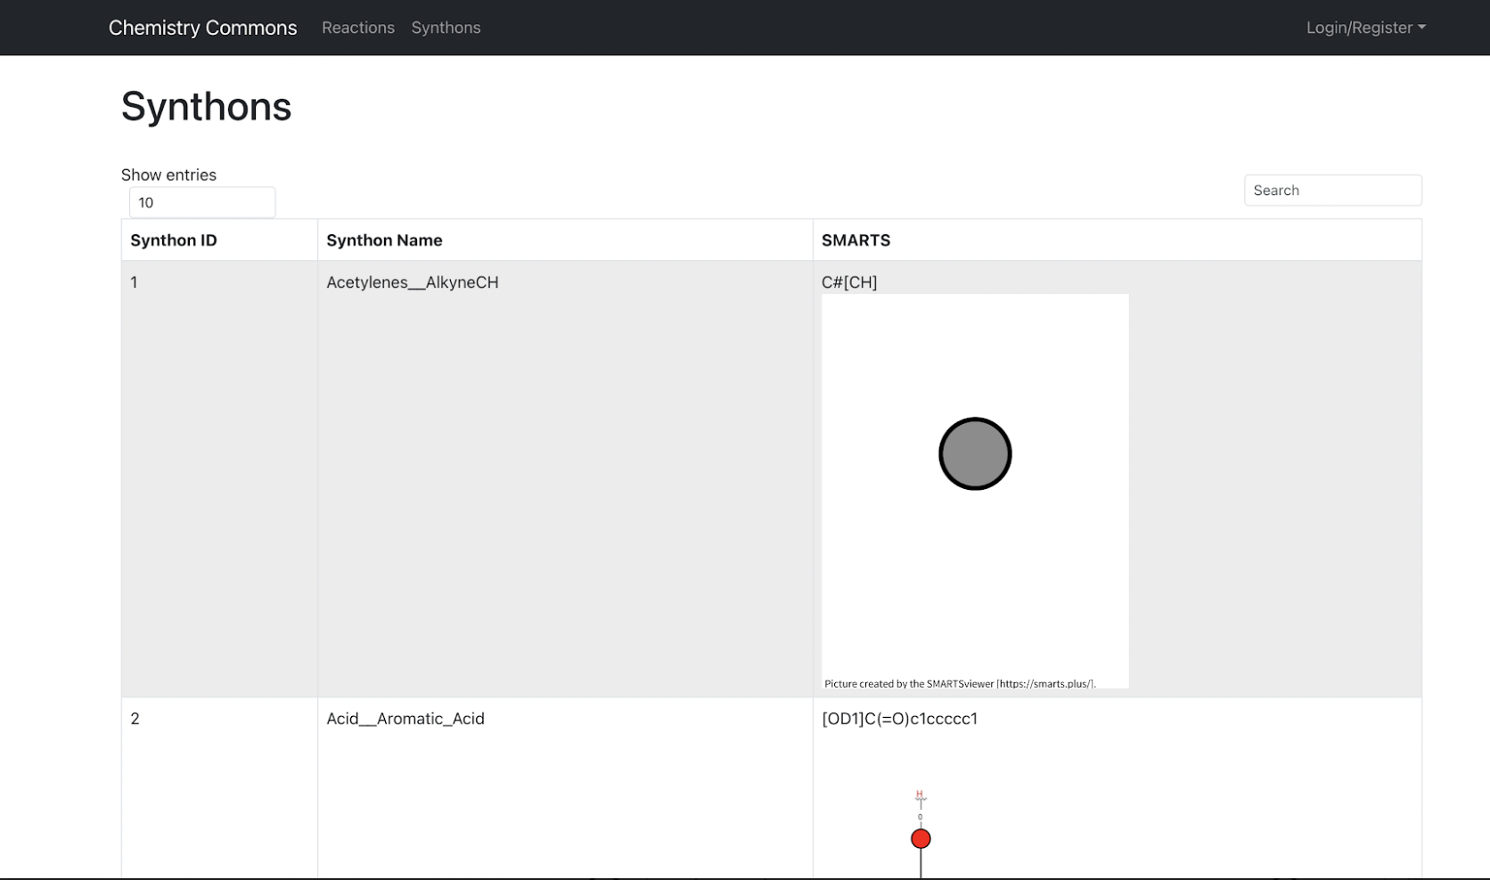
Synthon Database
Notes:
Chemistry Commons is also a database for synthons. Allows for the curation of specific synthon SMARTS.

Slide 5
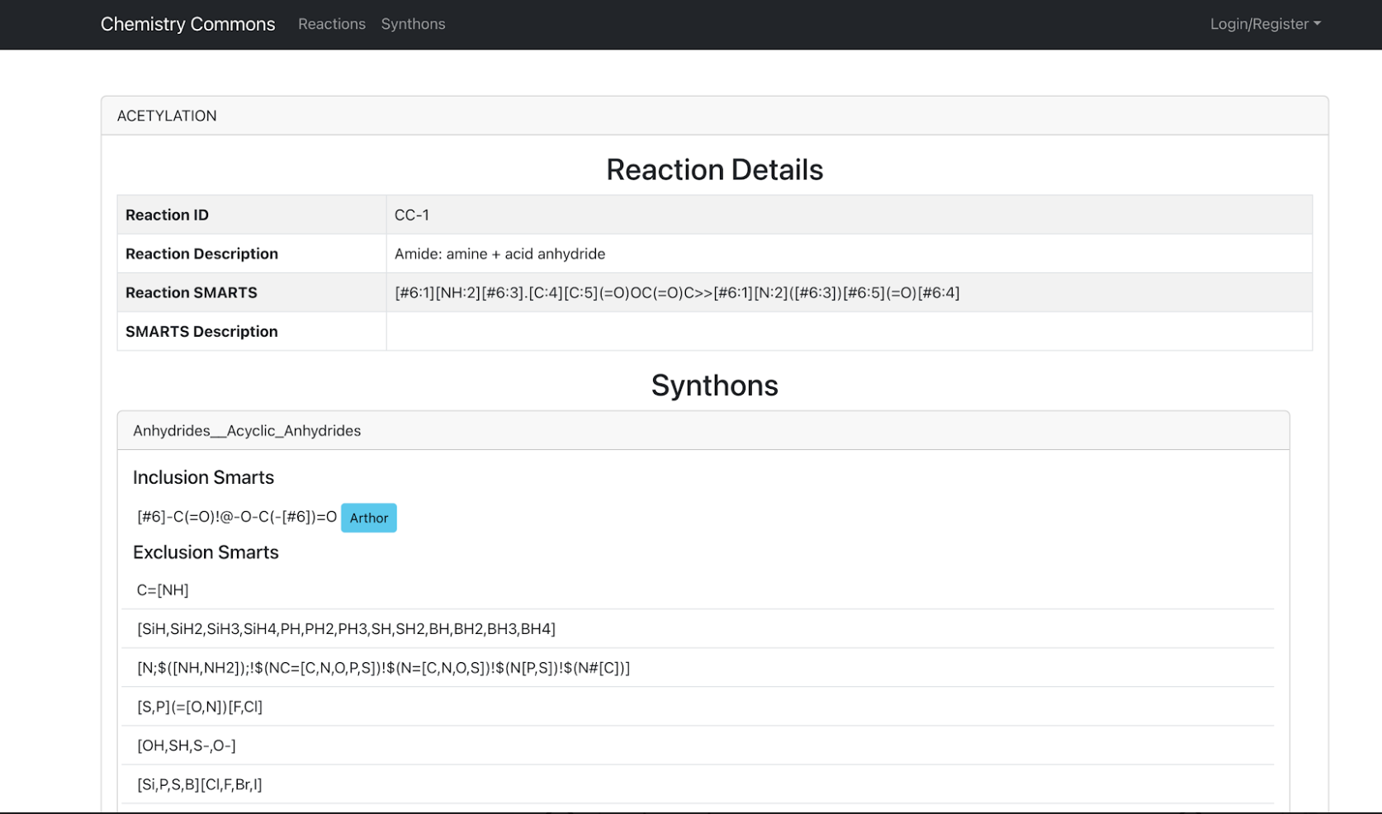
Reaction Details
Notes:
Each reaction has a detail page. Includes description, ID, reaction SMARTS, and In/Exclusion SMARTS SMARTS can be visualized with the aid of Arthor.docking.org or Smarts.plus

Slide 6
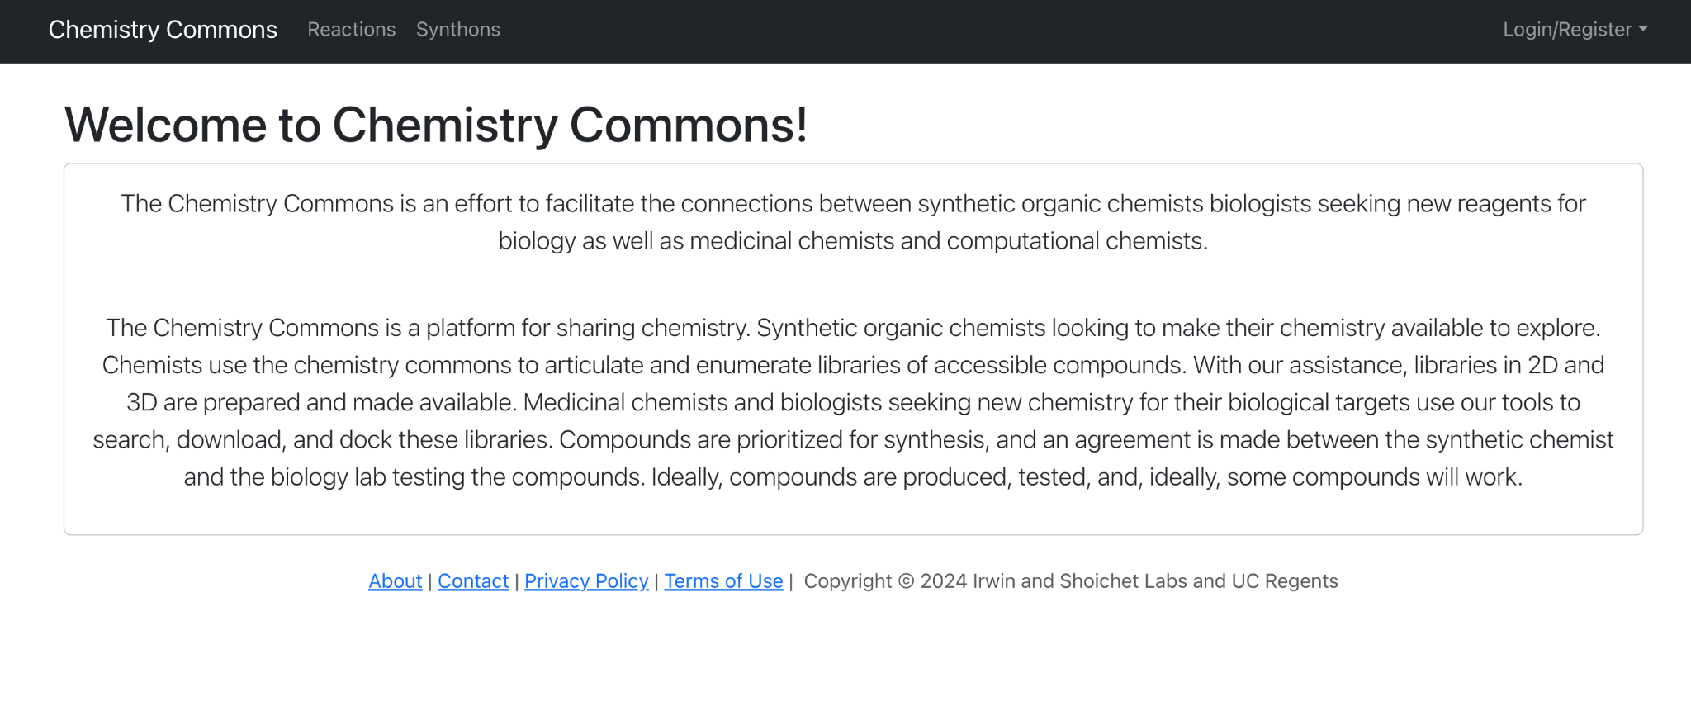
How to add a Reaction into the Chemistry Commons.
Notes:
Let’s say you want to add a Reaction into the Chemistry Commons that is not already in the Chemistry Commons because you want to do Enumeration, Analoging, or simply want to put your reaction in a database either for your own purposes or share it for everyone to use! To do that first click on the Reactions tab.

Slide 7
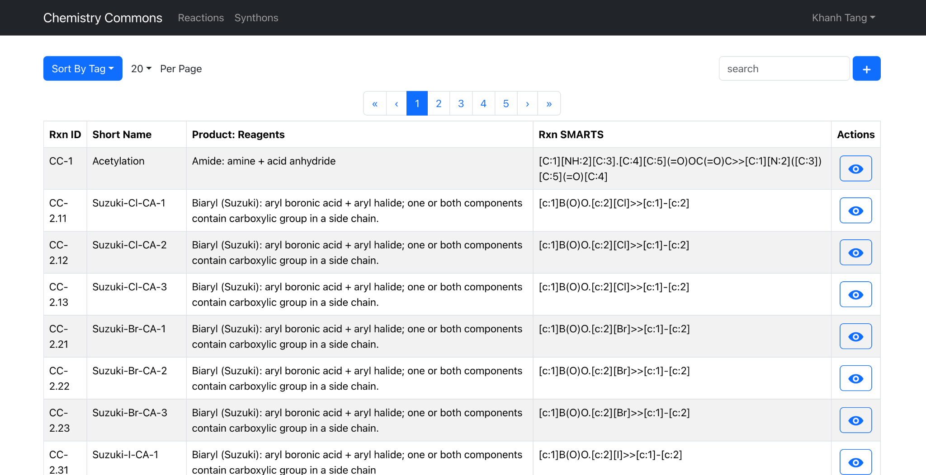
How to add a Reaction into the Chemistry Commons.
Notes:
Then Click on the plus sign in the corner and this should take you to the reaction curation page of the Chemistry Commons

Slide 8
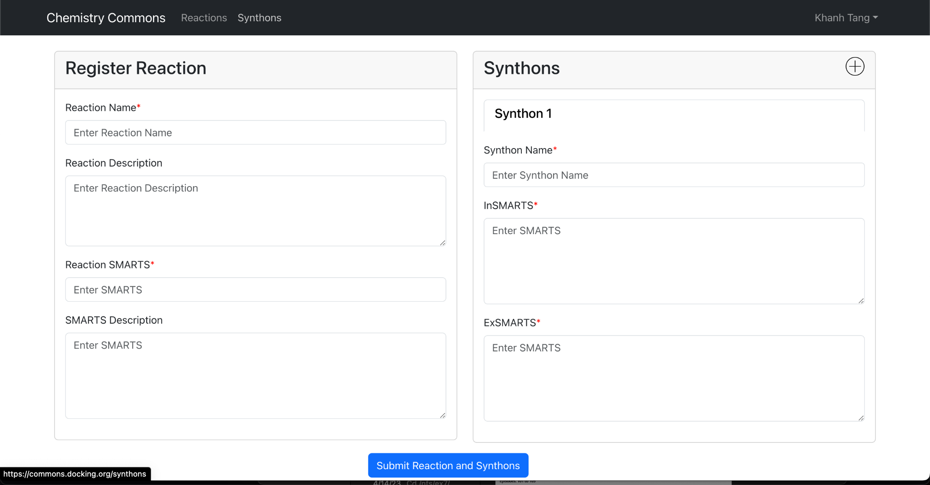
Enter in Reaction Details and Submit!
Notes:
This is a blank Reactions page that needs to be filled in with Synthon Name(s), Exclusion SMARTS, Inclusion SMARTS, and Reaction name/SMARTS

Slide 9
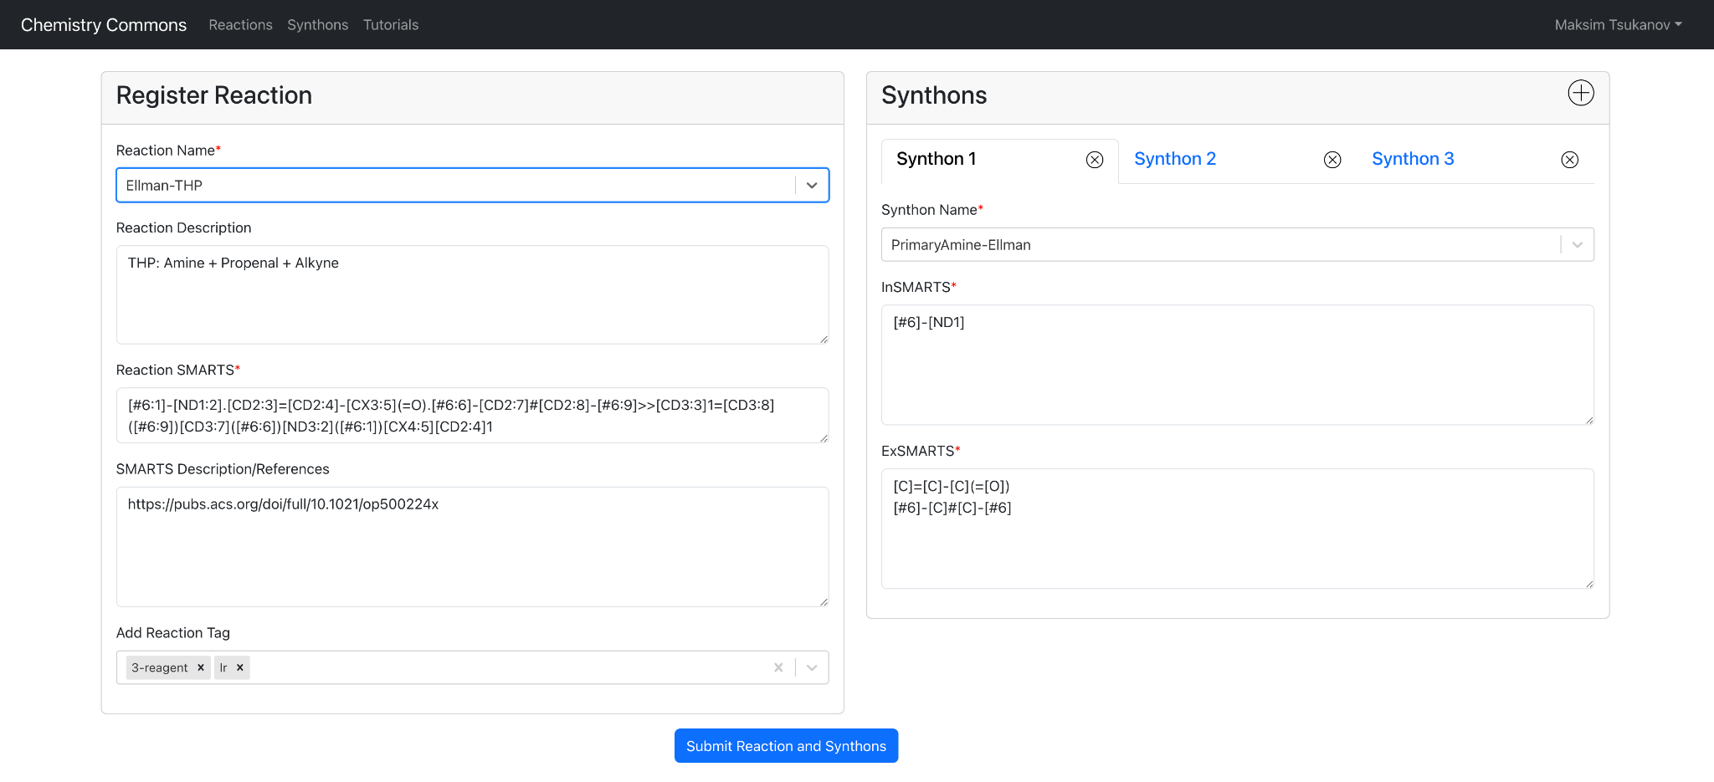
Enter in Reaction Details and Submit!
Notes:
This is how the page looks like when it is fully finished. The Example used here is the Ellman-Tetrahydropyridine reaction. Once you are done click submit and our Chemists will look over and verify the reaction for it to published if you want the reaction to be public. If it is not accepted for public use an email will be sent out that revisions need to be made.

Slide 10
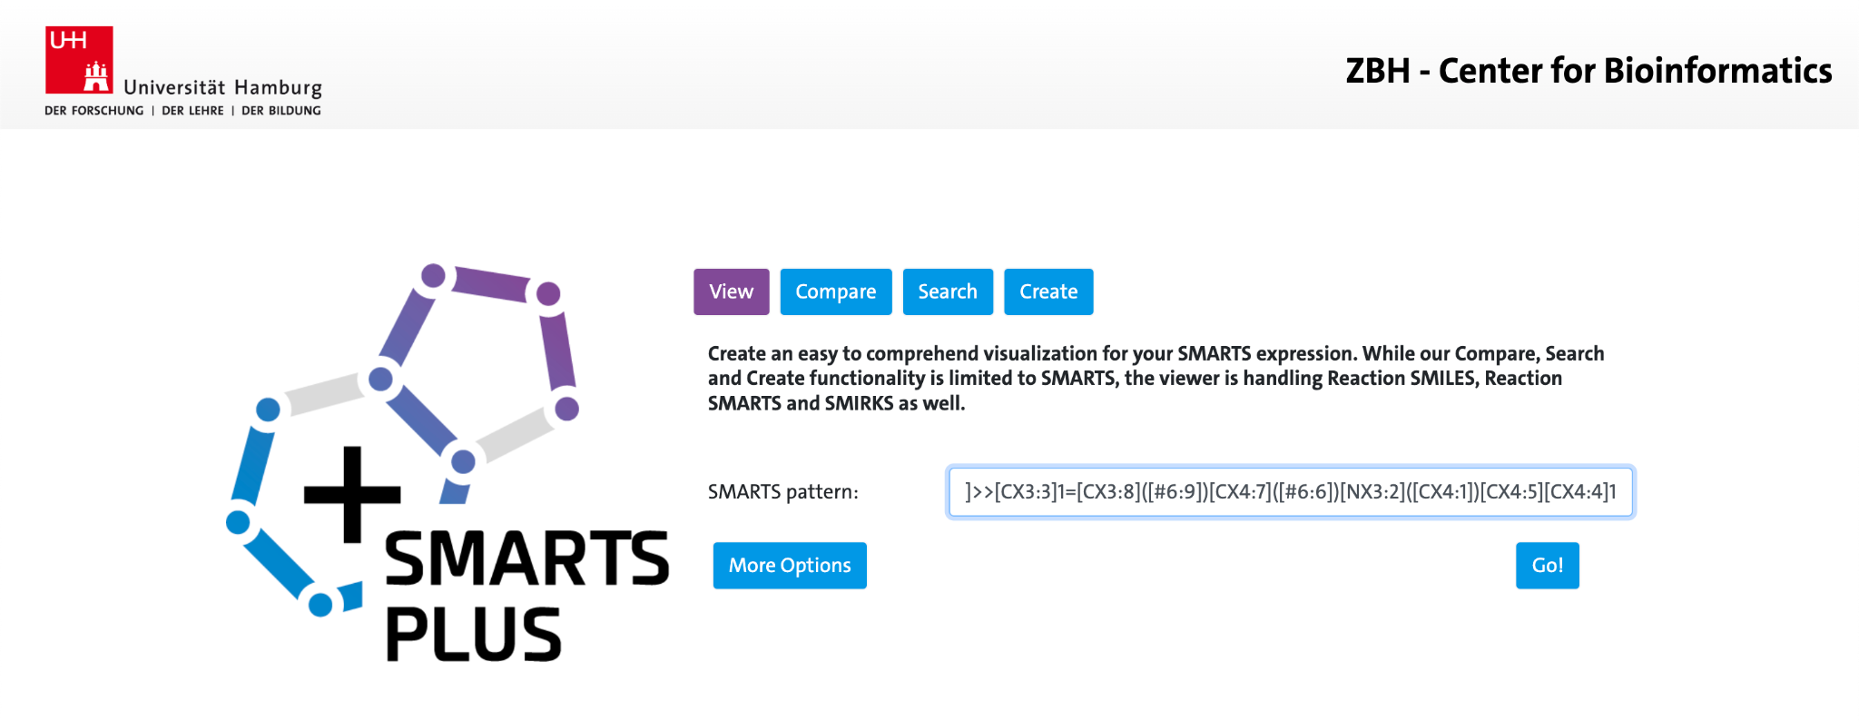
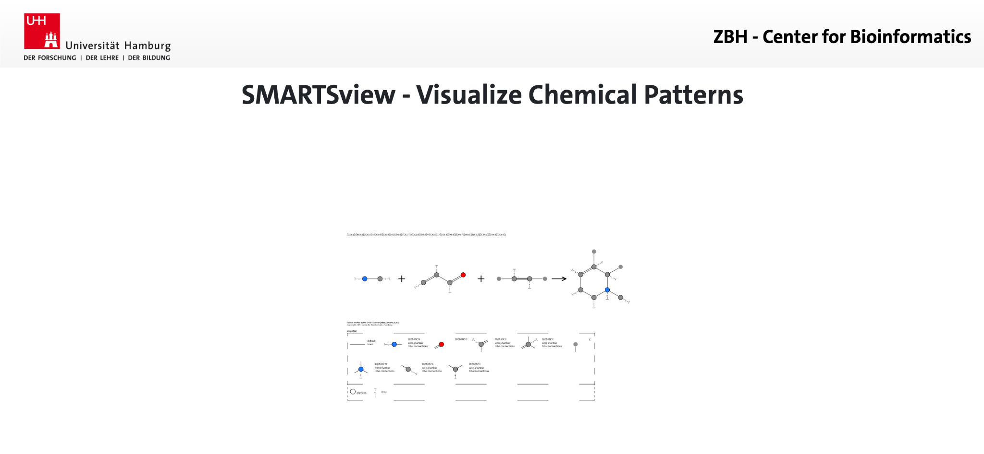
First Step is to learn SMARTS Resources
Smarts Plus
Daylight SMARTS
These are useful resources in helping learn the syntax of SMARTS, visualize SMARTS, as well as seeing if the SMARTS patterns are valid or not
Notes:
Next we will take the user through the user through the some helpful resources and necessary steps to help get started on curating these reactions SMARTS.

Slide 11
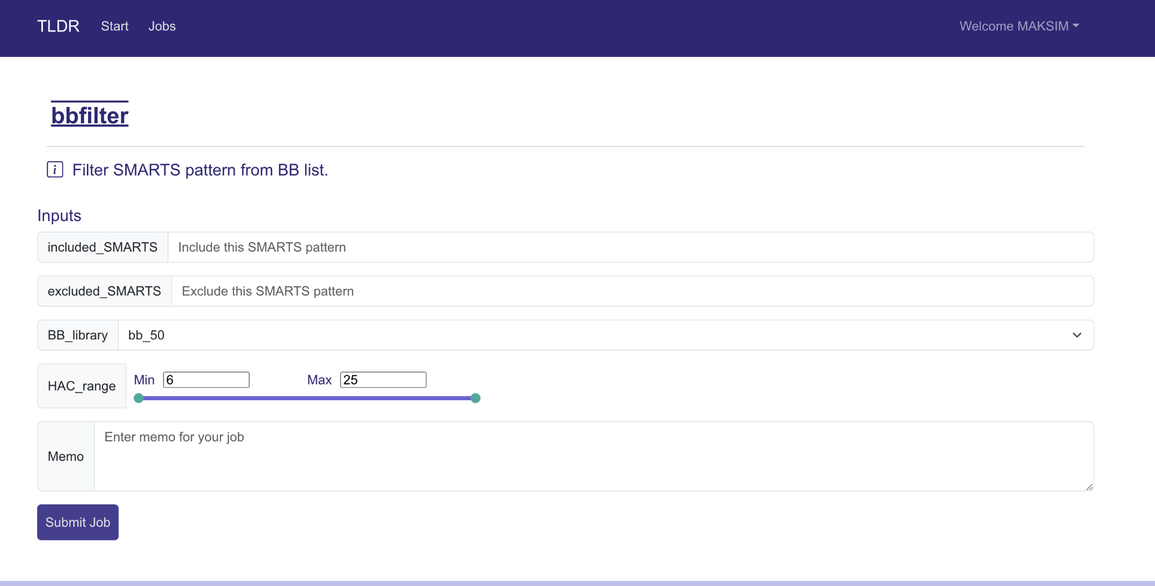
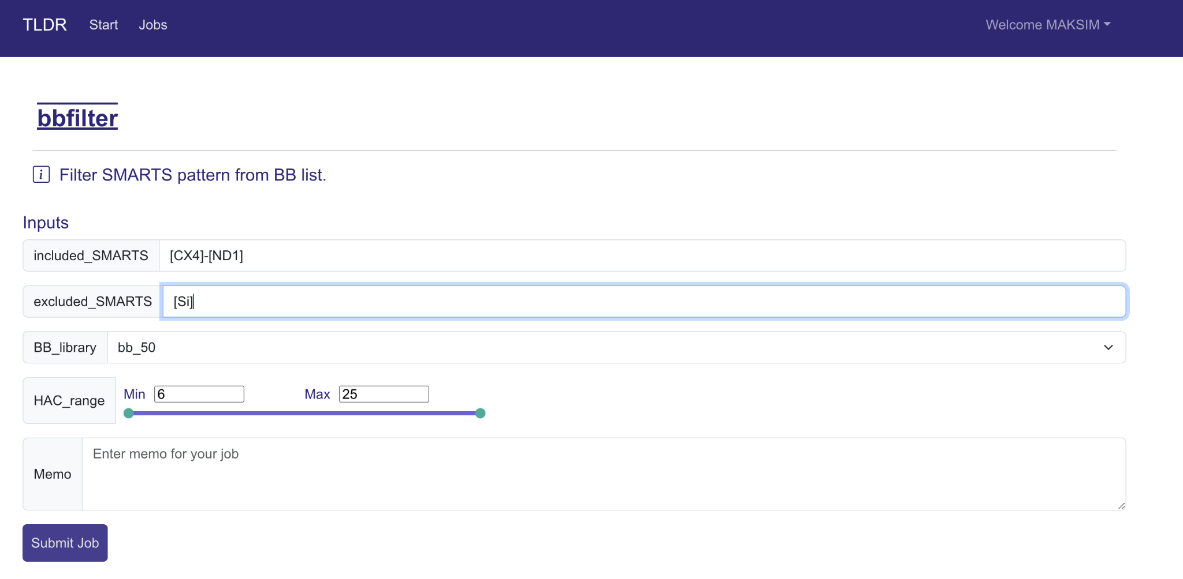
First Step is to learn SMARTS Resources
BBFilter module on tldr.docking.org
This is a module on from our own tool that helps verify your inclusion and exclusion SMARTS
Notes:
TLDR is a Website made and managed by the Irwin lab that has many useful tools. BBFilter is a great tool that is helpful in reaction curation. When making a reaction the user has to specify what parts of a reactant are necessary for each reactant or building block to have as well as what the reactant should NOT have. These are what in/ex SMARTS are. The tool uses a library that searches through all eligible molecules based on the inputted in/ex SMARTS and an output file of eligible molecules should be generated. If your file is missing molecules you thought would be eligible or has incorrect output, you can then tweek the in/ex SMARTS based on the output file to get closer to what you are searching for

Slide 12
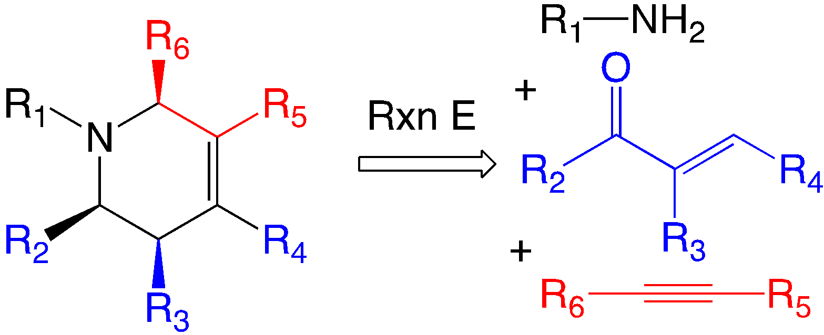
Transforming the Reaction into SMARTS
Figure out the reaction that you want to transform into SMARTS!
In this example we are transforming, Ellman’s Tetrahydropyradine reaction
3 Component Reaction that transforms into a small ring

Slide 13
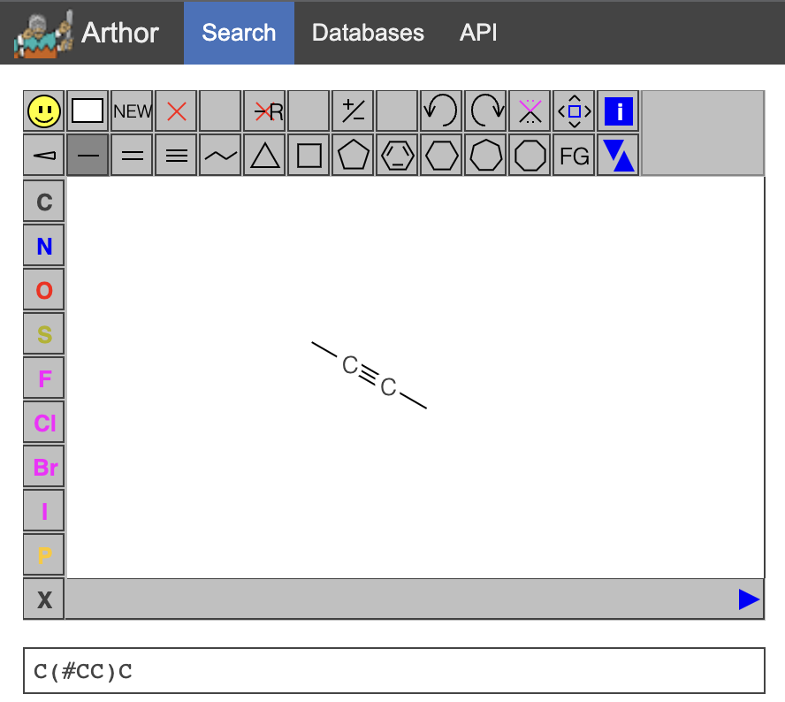
Transforming the Reaction into SMARTS: Finding the SMILES of each Reactant
First step is to figure out the SMILES of the reactant(s) and product
You can do this simply by drawing the molecule in our tool Arthor and copying the SMILES output by the drawing tool

Slide 14
Transforming the Reaction into SMARTS: R Group SMARTS
After you figure out the SMILES of each component, now specify the R-group bond order/connections using SMARTS notation if this is required for your reaction
Example: [C]=C-C(=O) -> [CD2]=C-C(=O)

Slide 15
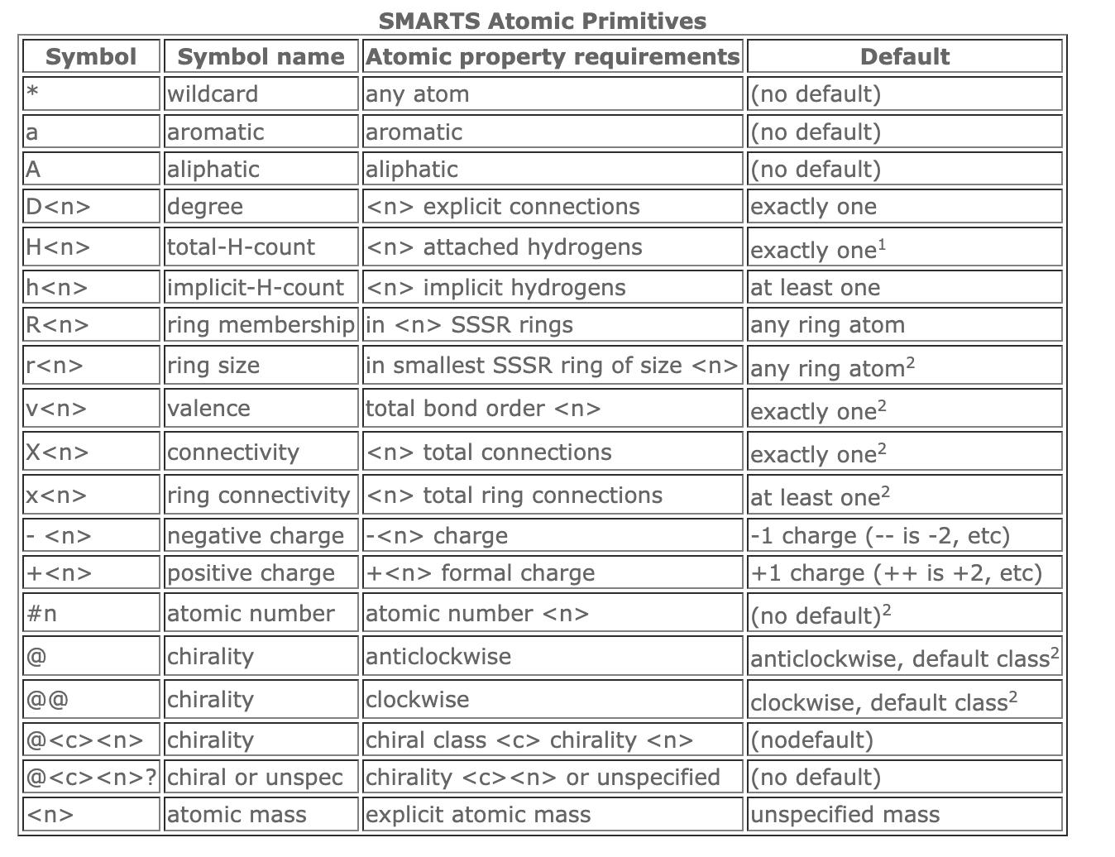
Transforming the Reaction into SMARTS: Daylight Resource
Again Daylight SMARTS is a good resource if you need to learn SMARTS notation

Slide 16
Transforming the Reaction into SMARTS: Inclusion SMARTS
At the step you should have the some simplified SMARTS of each component
1. amine
[#6]-[ND1]
4. Tetrahydropyridine
2. propenal
C1=C([#6])C([#6])N(C)CC1
[CD2]=C-C(=O)
3. alkyne
[#6]-[C]#[C]-[#6]
Notes:
This takes a while so don’t be discouraged!

Slide 17
Transforming the Reaction into SMARTS: Bond SMARTS
Save the SMARTS from the previous step as these will be our inclusion SMARTS
Next step is to specify bonds further!
1. amine
4. Tetrahydropyridine
[#6]-[ND1]
2. propenal
[CD3]1=[CD3]([#6])[CD3]([#6])[ND3]([#6])[CX4][CD2]1
[CD2]=[CD2]-[CX3](=O)
3. alkyne
[#6]-[CD2]#[CD2]-[#6]
Notes:
X is explicit notation and D is implicit notation. You might need to go back to this step later and see what works best for your reaction.

Slide 18
Transforming the Reaction into SMARTS: Mapping Atoms
Next is to Map the atoms in the reactants into the product (long step)
1. amine
[#6:1]-[ND1:2]
4. Tetrahydropyridine
2. propenal
[CD3:3]1=[CD3:8]([#6:9])[CD3:7]([#6:6])[ND3:2]([#6:1])[CX4:5][CD2:4]1
[CD2:3]=[CD2:4]-[CX3:5](=O)
3. alkyne
[#6:6]-[CD2:7]#[CD2:8]-[#6:9]
Notes:
This can be done by the addition of the :# notation as the last part in the brackets of each atom. The atom in the product that corresponds to an atom in the react should be the same #

Slide 19
Transforming the Reaction into SMARTS: Combining it all together
Now these parts can be all put together to get your reaction SMARTS!
Ellman’s Tetrahydropyridine Reaction
[#6:1]-[ND1:2].[CD2:3]=[CD2:4]-[CX3:5](=O).[#6:6]-[CD2:7]#[CD2:8]-[#6:9]>>[CD3:3]1=[CD3:8]([#6:9])[CD3:7]([#6:6])[ND3:2]([#6:1])[CX4:5][CD2:4]1
Notes:
Reactants are separated by a period(.) and products are separated from reactants by a double arrow(>>)

Slide 20

Transforming the Reaction into SMARTS: Filtering the Reagents
Now it’s time to think about what should and should not be allowed for each reactant
These will be our Inclusion/Exclusion SMARTS

Slide 21
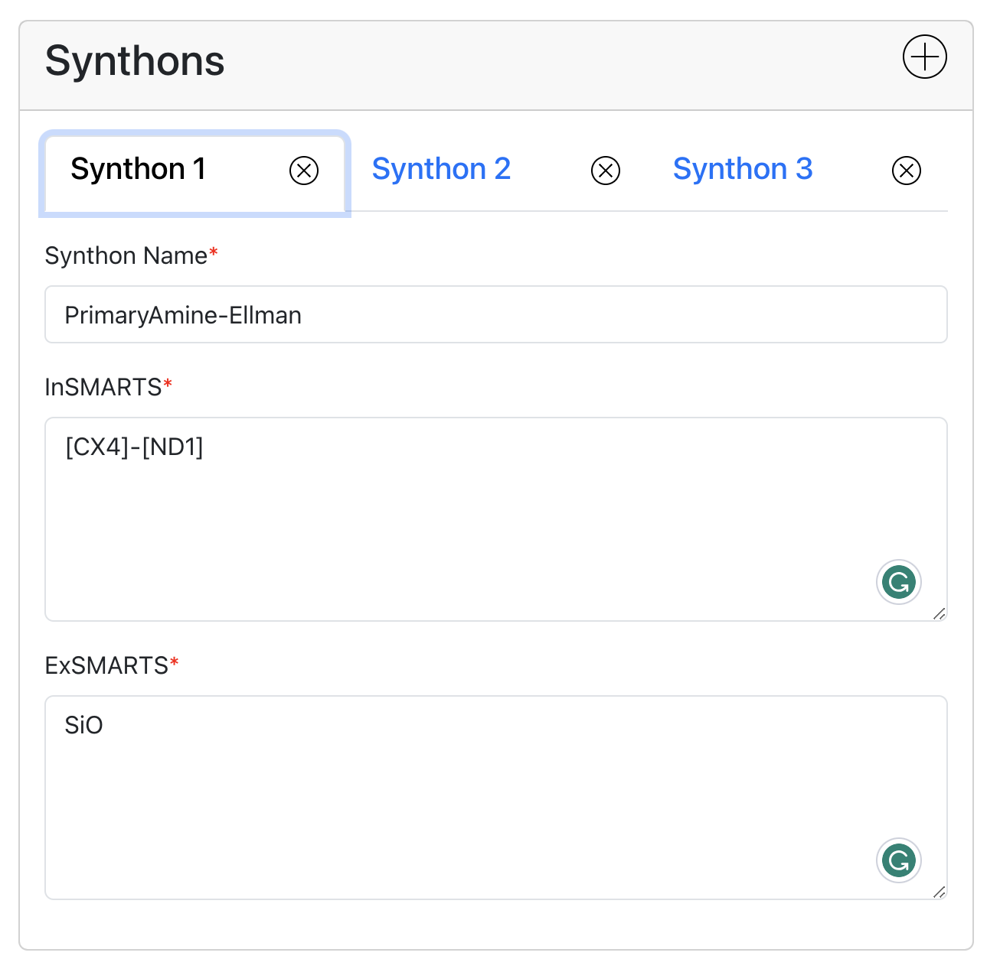
Transforming the Reaction into SMARTS: Inclusion/Exclusion SMARTS
Inclusion SMARTS were already made earlier though making the reaction SMARTS!
As for Exclusion SMARTS it can be and string of molecules that should not work as a reactant. Example: Anything with SiO in it

Slide 22
Transforming the Reaction into SMARTS: Testing Inclusion/Exclusion SMARTS
You can use the bbfilter module in TLDR to test Inclusion/Exclusion SMARTS to see if you get sensible molecules or if you’re filtering too many!

Slide 23
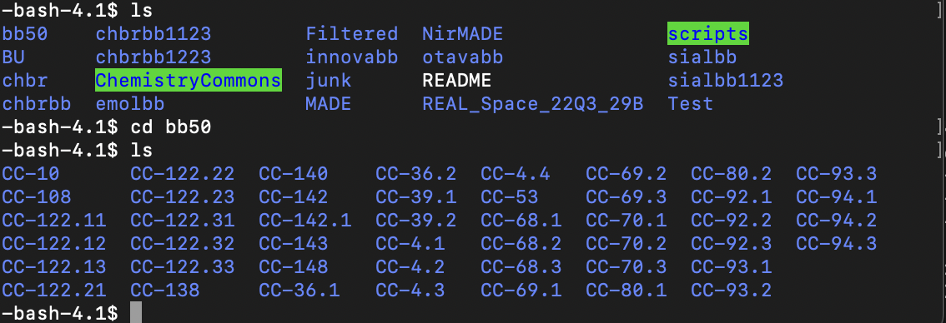
Enumeration and Debugging!
Once you feel more or less confidant with your Reaction and Inclusion/Exclusion SMARTS it is time to run some Enumeration to test your SMARTS!
Notes:
We hope to at some point have Enumeration within the graphical user interface of Chemistry Commons but for right now we have to run them on the command line.

Slide 24
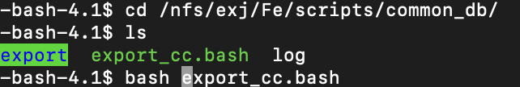
Exporting Chemistry Commons Reaction
-Once you have made your reaction on Chemistry commons it’s time to export your JSON containing the reaction into the command line!
Notes:
Go into this directory: cd /nfs/exj/Fe/scripts/common_db/export/
Run this script: bash export_cc.bash

Slide 25
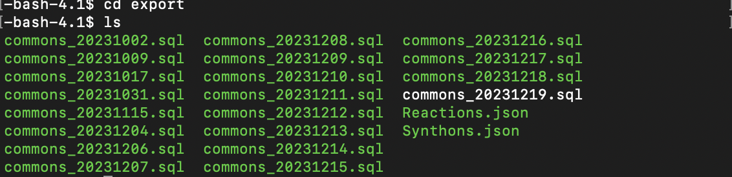
Finding Reaction and Synthon JSONs
-Once run the export script you can find the Reactions.json and Synthons.json in the export directory
Notes:
Check the JSONs to make sure the import script ran correctly

Slide 26
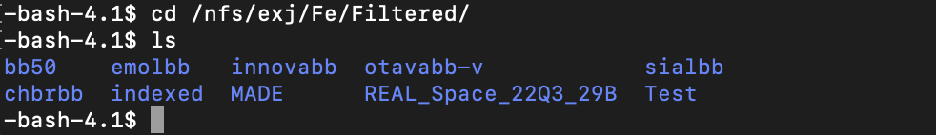
Picking library to Enumerate
From experience it’s best to pick a larger library to Enumerate to make sure there are enough molecules in the database, such as bb50.
However, if you need quick results I recommend Sialbb.
Notes:
Going into the directory: cd /nfs/exj/Fe/Filtered/

Slide 27
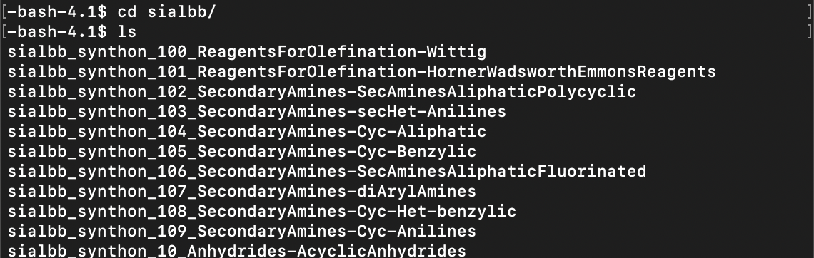
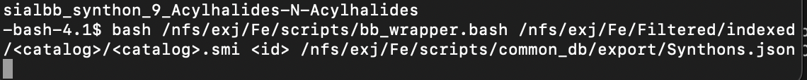
Filtering Synthons
Go into the library of your choosing and run the filtering command below for each synthon
Notes:
Script: bash /nfs/exj/Fe/scripts/bb_wrapper.bash /nfs/exj/Fe/Filtered/indexed/<catalog>/<catalog>.smi <id> /nfs/exj/Fe/scripts/common_db/export/Synthons.json
<catalog>: Catalog you are using ex. sialbb, <id>: synthonid you want to filter

Slide 28
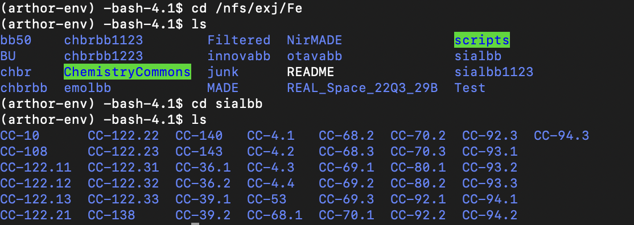
Enumeration: Part 1 of 3
First step is to source the environment:
Next step is to go into Library Enumeration Directory or create your own!
Notes:
Source Environment: source /nfs/home/ak87/exa/UCSF/SynthI/BESPOKE/arthor-env/bin/activate
Directory: cd /nfs/exj/Fe, cd <library you want to enumerate in> or cd <own directory>

Slide 29
Enumeration: Part 2 of 3
Inside create a directory using the following Syntax: mkdir CC-<Reaction ID>
Go inside the directory and run the first enumeration script:
Notes:
Script: python3 /nfs/exj/Fe/scripts/Enumeratorsplit.py -i <Synthonfile1 from filtering step> <Synthonfile2 from filtering step> -r CC-<Reaction ID> -o <library> -e /mnt/nfs/exj/Fe/Filtered/Test/EXAMPLE_Library_Enumeration_File_hg2_noProtected_logP350_HAC35_RotB7_V3_A-AK1.json -a /nfs/exj/Fe/scripts/common_db/export/Reactions.json
<Synthonfile>: Synthonfile in filtering directory, <ReactionID>: Reaction ID of your reaction, <library>: libraryname of the library you are using

Slide 30
Enumeration: Part 3 of 3
Now after first script is finished, run the final script in the same directory.
After a certain amount of time you should have Enumerated your reaction!
Notes:
Script: python3 /nfs/exj/Fe/scripts/Enumeratorcombine.py -i <pairing file> -r CC-<Reaction ID> -o <library> -e /mnt/nfs/exj/Fe/Filtered/Test/EXAMPLE_Library_Enumeration_File_hg2_noProtected_logP350_HAC35_RotB7_V3_A-AK1.json -a /nfs/exj/Fe/scripts/common_db/export/Reactions.json
<pairing file>: pairing file made by previous script, <ReactionID>: Reaction ID of your reaction, <library>: libraryname of the library you are using

Slide 31
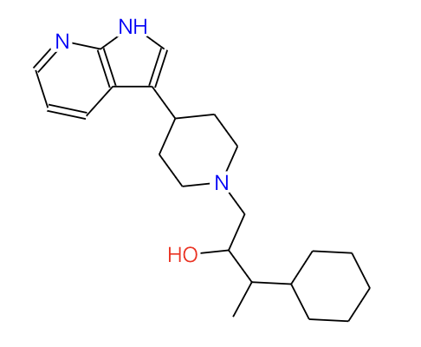
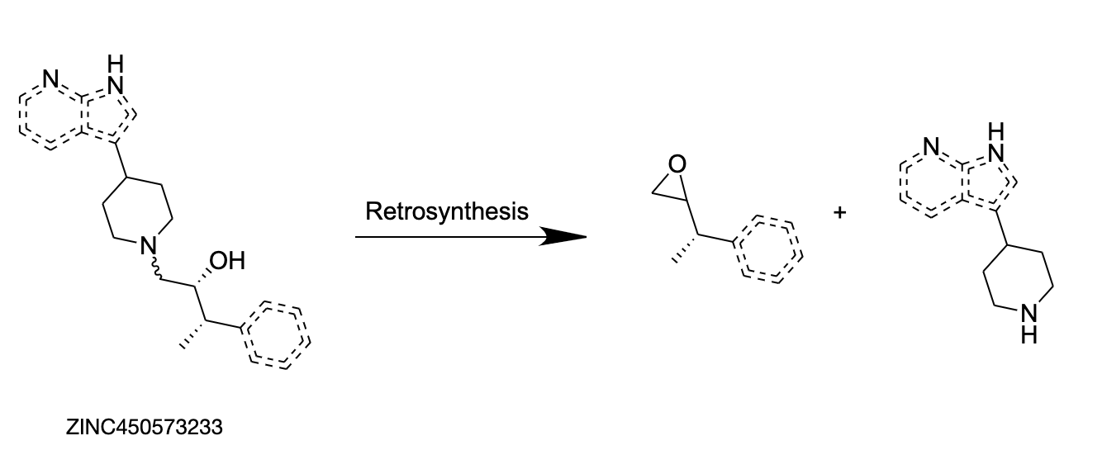
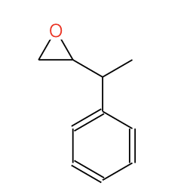
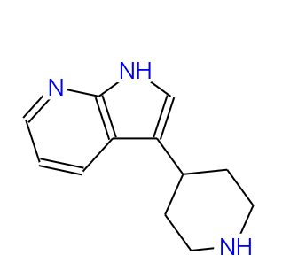
Analog By Building Block Tool or AB3
-Retrosynthesis is the process of taking a molecule and breaking it apart into building blocks
-We can use this concept to access a new area of purchasable chemical space!
ZINC450573233 a hit for the σ2 receptor
Alon A, Lyu J, Braz JM, Tummino TA, Craik V, O'Meara MJ, Webb CM, Radchenko DS, Moroz YS, Huang XP, Liu Y, Roth BL, Irwin JJ, Basbaum AI, Shoichet BK, Kruse AC. Structures of the σ2 receptor enable docking for bioactive ligand discovery. Nature. 2021 Dec;600(7890):759-764. doi: 10.1038/s41586-021-04175-x. Epub 2021 Dec 8. PMID: 34880501; PMCID: PMC8867396.
Notes:
For example an epoxide ring opening reaction.

Slide 32
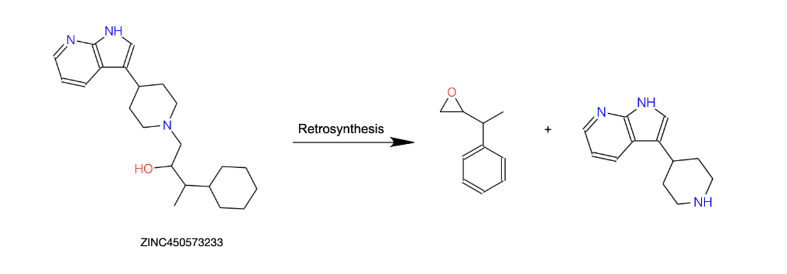
Analog By Building Block Tool or AB3
Use a sturdy retrosynthetic reaction to break down a molecule into building blocks
Find purchasable analogs of the building blocks by doing a similarity search
The respective building blocks can now be recombined with a forward reaction to find a final analog of the starting molecule
ZINC450573233 a hit for the σ2 receptor
Alon A, Lyu J, Braz JM, Tummino TA, Craik V, O'Meara MJ, Webb CM, Radchenko DS, Moroz YS, Huang XP, Liu Y, Roth BL, Irwin JJ, Basbaum AI, Shoichet BK, Kruse AC. Structures of the σ2 receptor enable docking for bioactive ligand discovery. Nature. 2021 Dec;600(7890):759-764. doi: 10.1038/s41586-021-04175-x. Epub 2021 Dec 8. PMID: 34880501; PMCID: PMC8867396.

Slide 33
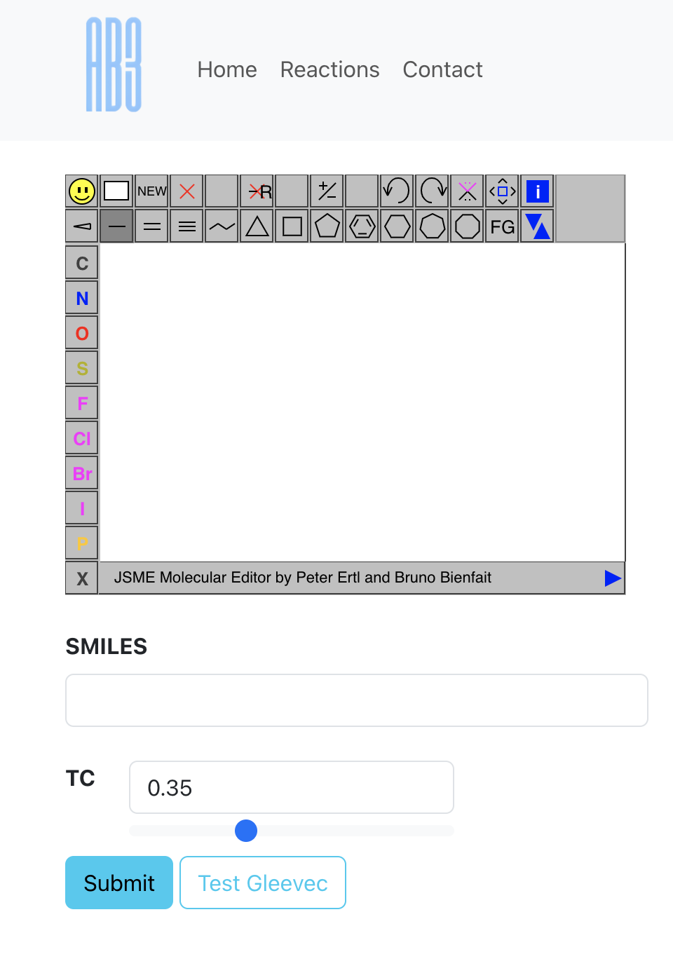
Interface
-Draw your molecule of interest or just put in the SMILES in the input box

Slide 34
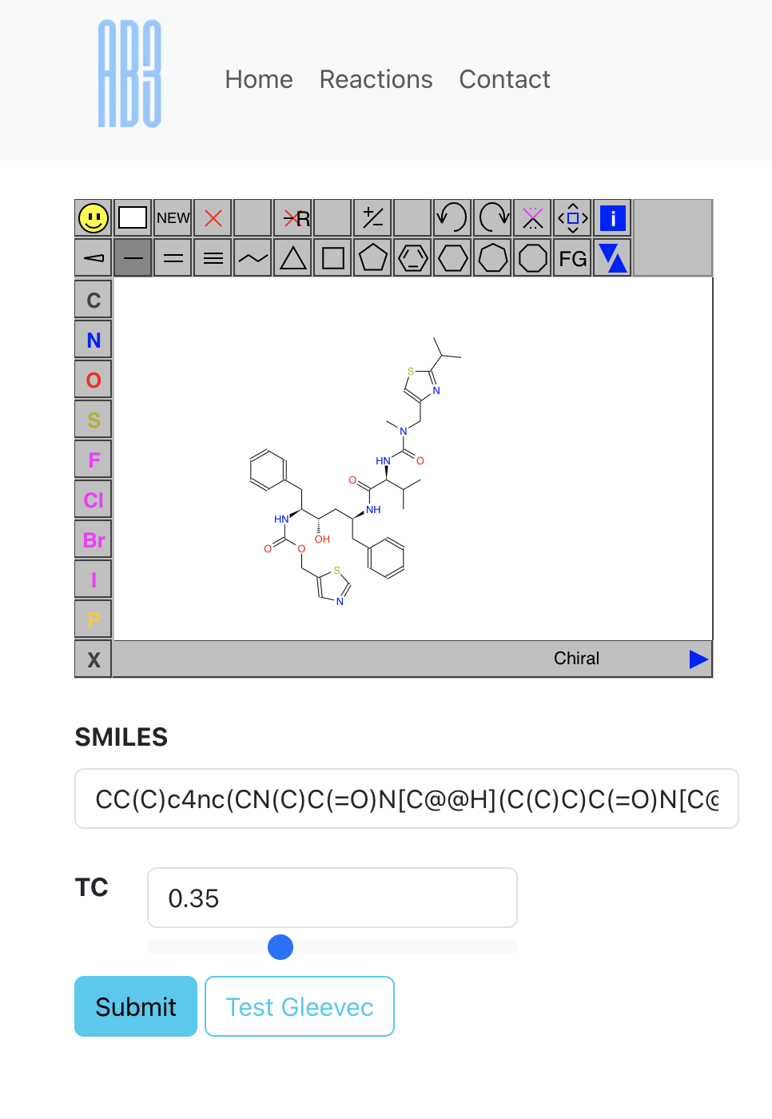
Interface
-Draw your molecule of interest or just put in the SMILES in the input box
-Set your TC value and hit submit!

Slide 35
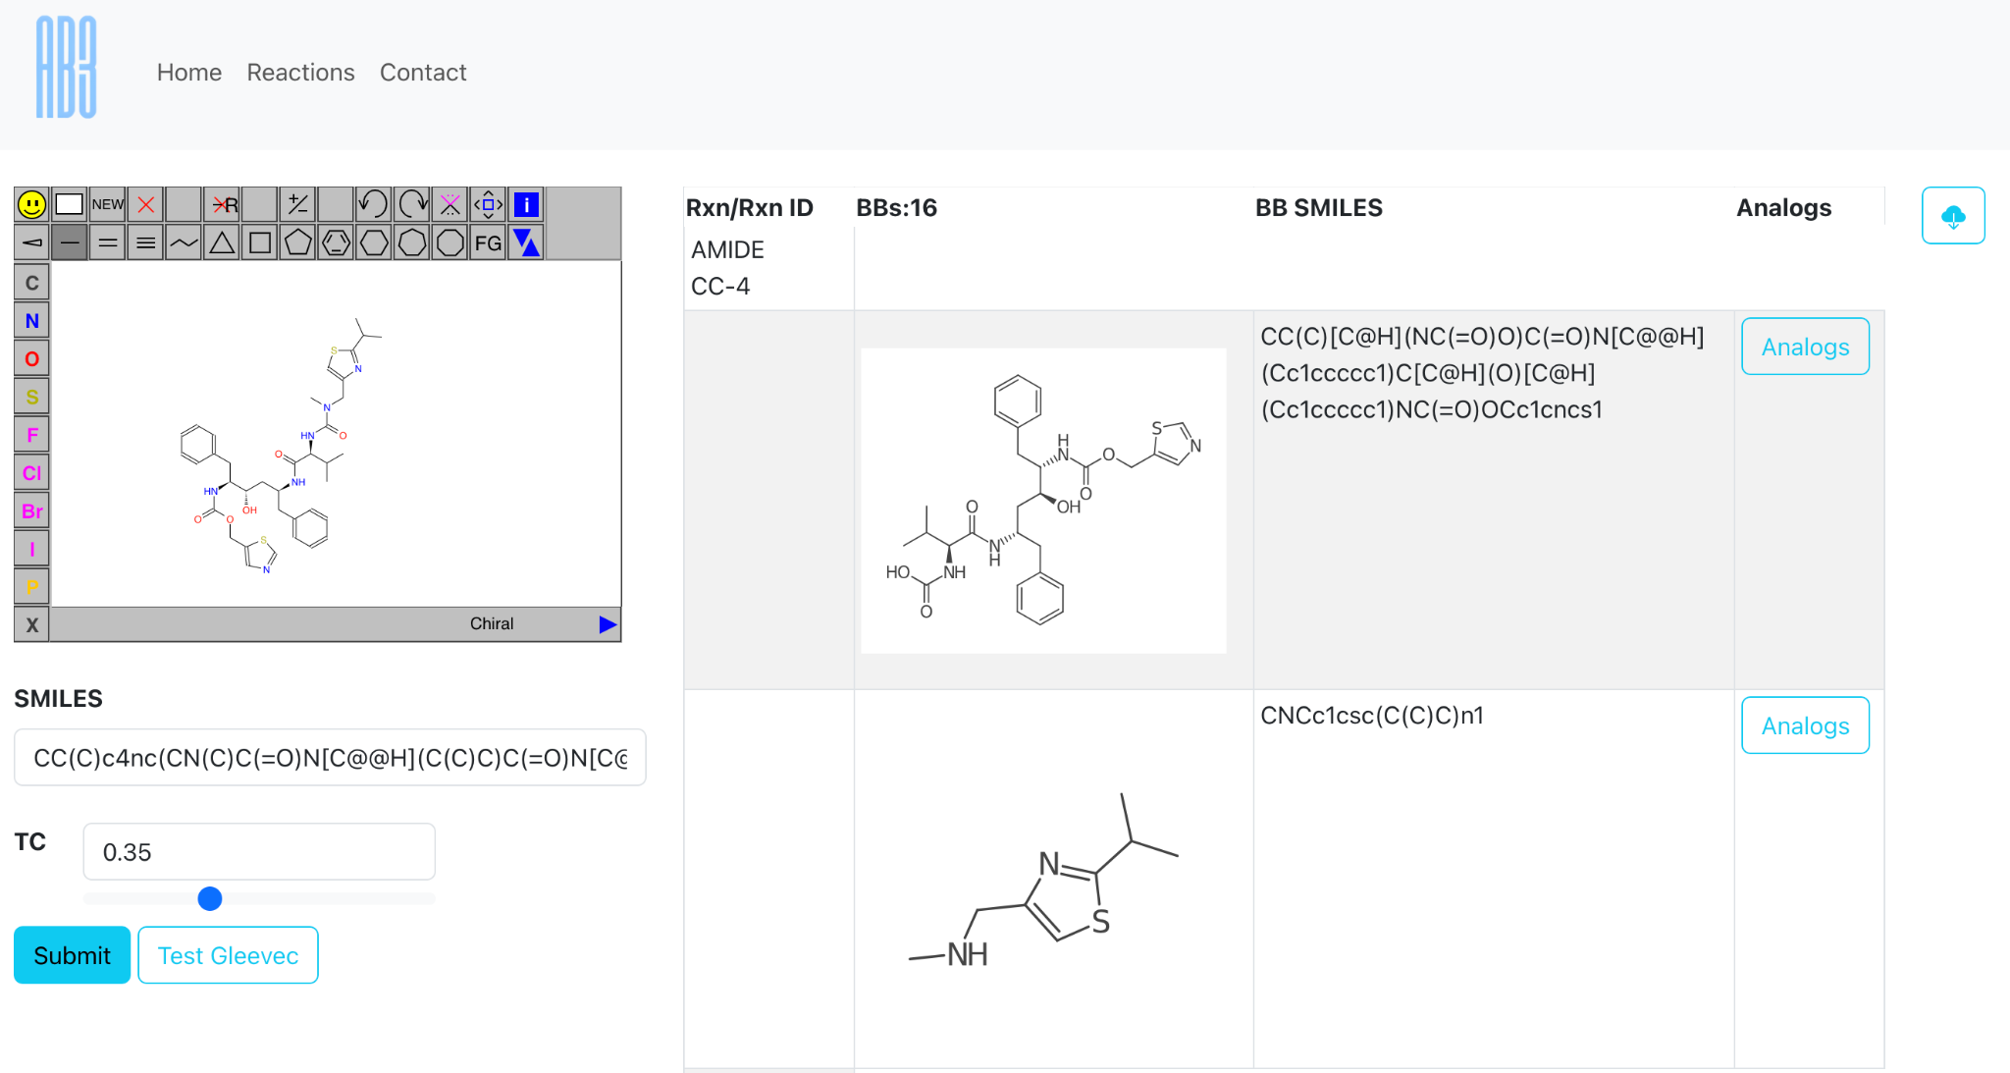
Finding Analogs of Novel Molecules: 1 of 8
Ritonavir a new FDA approved drug to treat HIV/AIDS

Slide 36
Finding Analogs of Novel Molecules: 2 of 8
Retrosynthesis results on the right

Slide 37
Finding Analogs of Novel Molecules: 3 of 8
Each retrosynthesis has atleast two results

Slide 38
Finding Analogs of Novel Molecules: 4 of 8
Download Retrosynthesis Results

Slide 39
Finding Analogs of Novel Molecules: 5 of 8
Press Analogs to View Purchasable Analogs of BB

Slide 40
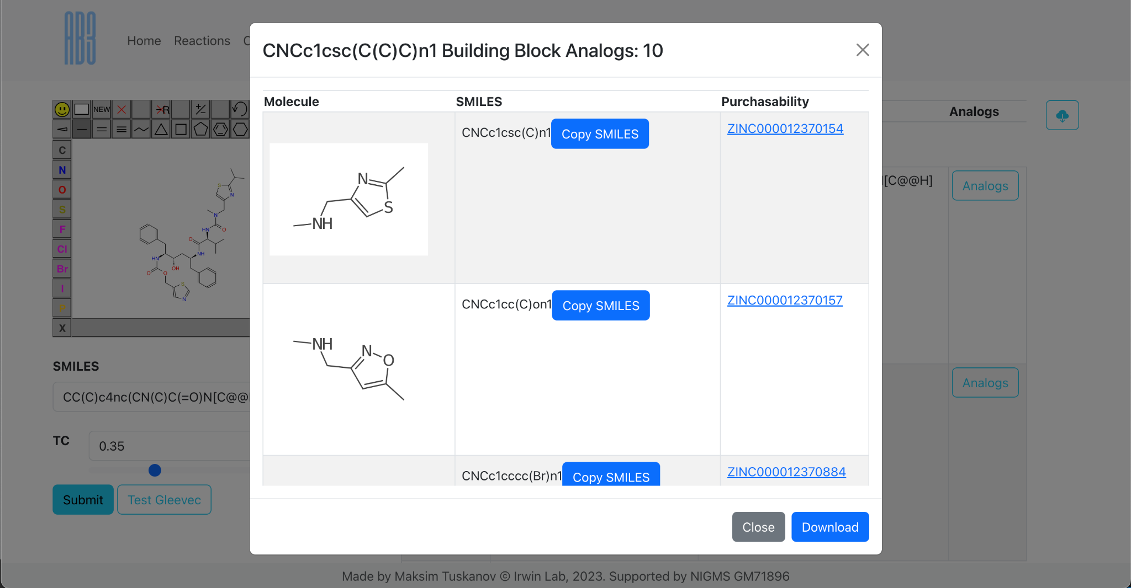
Finding Analogs of Novel Molecules: 6 of 8
Amount of Purchasable analogs for a single building block

Slide 41
Finding Analogs of Novel Molecules: 7 of 8
Purchasability Information

Slide 42
Finding Analogs of Novel Molecules: 8 of 8
Download Results

